Slide 1



PA 604
Survey Research
Professor Burrel Vann Jr

Slide 2
Survey
(Questionnaire)
A document with items designed to solicit information from participants
Items (questions or statements) about participants and aspects of their social life.
Items used to measure participants' attitudes, beliefs, perceptions, and orientations about the social world.
Notes:
participants AKA respondents
unit of analysis is usually the respondent/participant (individual level)

Slide 3
Types of Items
Closed-Ended
Open-Ended
Items in which the respondent is asked to select an answer from a list provided by the researcher.
Items in which the respondent is asked to provide their own unique answers.
Exhaustive: All possible options (attributes) are available to select
Mutually exclusive: Participants should only be able to select one option (attribute). Some exceptions (e.g. race/ethnicity)
Must be coded before they can be processed for analysis
Requires researcher to interpret meaning of responses

Slide 4
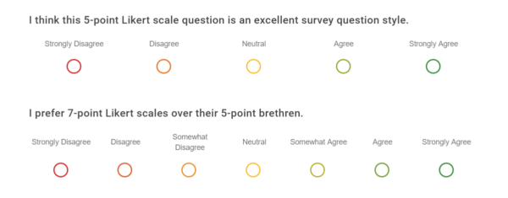
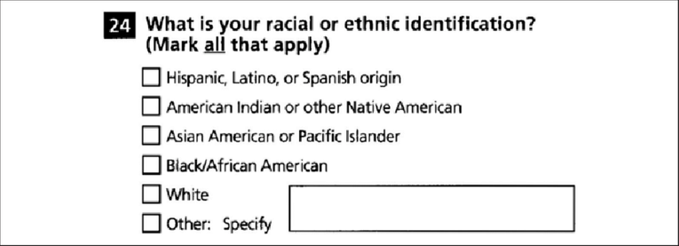
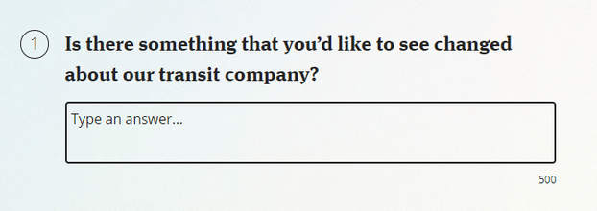
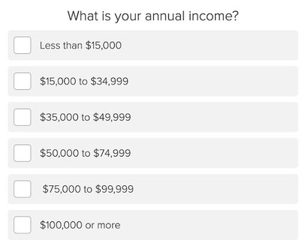
Types of Items
Closed-Ended
Open-Ended

Slide 5

Item Construction (Wording)
¨Make Items Clear
Items Should Be Short
¨Items Should Be Relevant
Items should be unambiguous
Allows respondent to quickly read and respond
Keeps respondent engaged with content of study
¨Avoid Double-Barreled Items
¨Avoid Negative Items
Including words like “not” can easily confuse respondents
Only discuss one topic per item
¨Respondents Must Be Willing to Answer
¨Respondents Must Be Able to Answer
Especially with interviewer administered surveys, some topics, respondents are uncomfortable talking about. May be more willing to respond to sensitive items if they are sure their responses are anonymous.
¨Avoid Biased Terms
Respondents should meet some age requirement, or have had relevant experience with the topic in the item. Topic must not be in so distant past that difficult to recall
Including negatively- or positively-slanted language in items encourages participants to respond in
amenable ways leading to biased responses

Slide 6
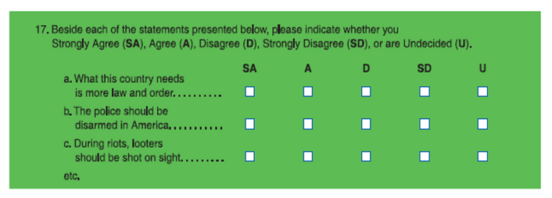
Survey Construction(Visual Design)
Uncluttered
One question per line
Consistent format
Item Ordering
Introductory comments and clear instructions at beginning
Demographic questions at end
matrix format for similar Likert items

Slide 7
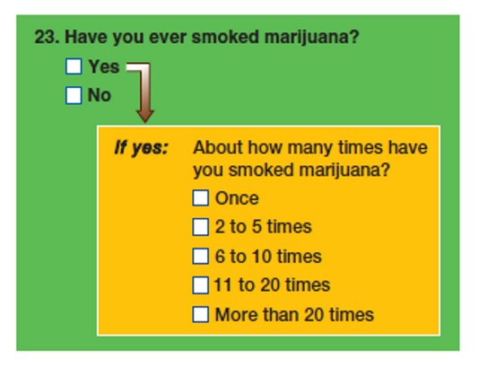
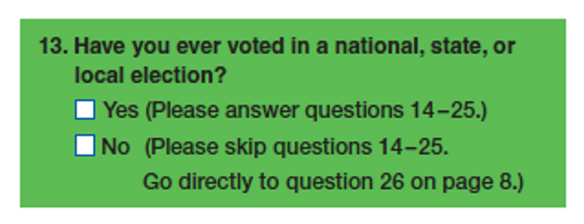
Survey Construction(Logic)
Some questions are intended only for certain respondents, based on their responses to prior questions
Called "survey logic" (sometimes called a contingency question)
logic in paper survey version
logic in web survey version

Slide 8
Self-Administered
Types of Survey Administration
Surveys in which respondents are asked to complete the questionnaire by themselves.
Interviewer-Administered
Surveys in which an interviewer asks questions of the respondent.
*Most surveys nowadays are self-administered (b/c it’s too costly to do interviewer-administered)

Slide 9
V
Ideal
Reality
Response Rate
>70% (>80% for federally-funded research surveys)
Ideal response rate rarely achieved nowadays
Response rate declining
~10% in some commercial surveys
~60% in some federally-funded surveys
The number of people who actually participate in a survey, divided by the number selected in the sample

Slide 10
Problems and Solutions for Response Rate
Why is low response rate bad?
How to improve response rate?
Smaller sample = less representative of population
Participants may be systematically different than non-participants
Use to interviewer-administered
Yield higher response rates (80-85%) than self-administered surveys by encouraging responses to items.
Minimize “don’t know” and “no answer”
Guard against confusion by clarifying items
Notes:
Interviewer must be neutral medium through which participant conveys their responses
However, participants may also feel like responding in more “socially-desirable” ways with the interviewer than they would have otherwise done in a self-administered survey.

Slide 11
Self-Administered Surveys
Mail
Web
Participants are mailed a hard copy of the survey, along with instructions, stationery, and postage for returning the completed survey
Costs – distribution, follow-up mailings and/or incentives for returning completed survey
Participants are emailed a link to an electronic/web survey
Costs – incentives for participation
Notes:
In mail… its just “too much work” sometimes for people to return their mail survey…. You can incentivize participants by offering a standard monetary gift (e.g. a preloaded card, or a gift card). Although non-response is a problem for both mail and email… the “cost” on participants is higher when using mail versus web surveys (it takes a lot more energy to figure out how to return a mail survey – putting in mail or dropping off at post office – than doing a web survey, which is auto-returned).

Slide 12
The Survey
Guidelines for Self-Administered Surveys
Use simple language
Test incentives, rewards, and prizes
Limit studies to less than 15 minutes
For Web Surveys:
Don't force excessive scrolling
Be aware of technical limitations

Slide 13
Interviewer-Administered Surveys
Face-to-Face
Telephone (Webcam, etc.)
Interviewer physically meets with participant, reads items orally, and records responses
Costs – interviewer pay and training, travel expenses, supplies and administration tools, incentives for participation
Interviewer meets with participant via alternative medium (e.g. telephone or webcam), reads items orally, and records responses
Costs – interviewer pay and training, phone/internet expenses, RDD and CATI expenses, office space, supplies and administration tools, incentives for participation
Notes on Telephone/Webcams
Random-Digit Dialing (RDD) – A sampling technique in which random numbers are selected from within the ranges of active telephone numbers.
Computer-Assisted Telephone Interviewing (CATI) – A data collection technique in which an interviewer relies on a computer, reading items from the survey and entering the answers on the computer

Slide 14
Training
Practice & “Real” interviews
Practice to handle difficult situations
Become familiar with questionnaire
Guidelines for Interviewers
The Interview
Dress appropriately
Follow question wording exactly
Record responses exactly
Probe when necessary
Probe – a technique employed interviewing to solicit a more complete answer to a question.

Slide 15
Comparisons of Survey Methods
Self-Administered
Mail vs. Web
Interviewer-Administered
Face-to-Face vs. Telephone (webcam)
Cheaper and faster than interviewer-administered surveys
Web is cheaper, more efficient than mailing
If mailing:
National is the same cost as local
Requires small staff to manage responses/follow-ups
Respondents more willing to answer controversial items than would in interview-administered
Fewer incomplete questionnaires
More effective for complicated questionnaires
Face-to-face is more intimate, but telephone/webcam is cheaper and more time efficient
Most people have phones, fewer people have internet or data packages
Telephone/webcam allow for increased personal safety
Telephones subject to opt-outs:
Unlisted numbers, DO-NOT-CALL registries, voicemails
Notes:
Interviewer must be neutral medium through which participant conveys their responses
However, participants may also feel like responding in more “socially-desirable” ways with the interviewer than they would have otherwise done in a self-administered survey.

Slide 16

Secondary Analysis and Surveys
Secondary Data Analysis
The Role of Surveys in Secondary Data Analysis
A form of research in which the data collected (and sometimes analyzed) by one researcher, which are then made (publicly) available to be (re)analyzed by other researchers.
Example: General Social Survey
Surveys, especially large, federally-funded surveys, are the most common method of creating secondary data for other researchers.
Notes:
Secondary data often also comes from official sources, whose data are readily available (e.g. websites, blogs, books, texts, autobiographies, journals, etc.) and whose content can be analyzed -- content/text analysis and historical case studies.
In few cases (but not none) are experiments, contemporaneous case studies, participant-observations, focus groups, and ethnographies, made available as secondary data for analysis

Slide 17
Surveys often ask for private information, which must be kept confidential.
Because asking questions can cause psychological discomfort or harm to respondents, researchers should minimize this risk.
Survey Ethics

